Slide 1
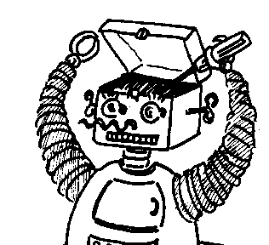
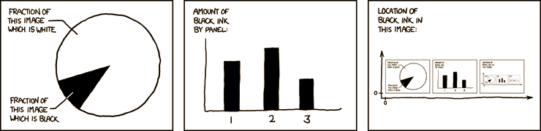

Maryland Metacognition Seminar
http://xkcd.com/
Aspects of Metacognition in OntoAgent
Professor SERGEI NIRENBURG
University of Maryland, BALTIMORE COUNTY
13 May 2011, 12:00 PM
CSI Center, RM. 3120
Abstract:
Ontoagent is a constantly evolving cognitive architecture that facilitates development of and experimentation with artificial intelligent agents (“ontoagents”). Ontoagents can be described by the following characteristics. Ontoagents model human information processing capabilities by simulating conscious perception and action, which involves reasoning and decision-making. They are intended to operate in a hybrid network of human and artificial agents, and they incorporate an ontological world model and a memory (“fact repository”) of instances of ontological objects, events and properties. In this talk I will briefly describe ontoagent as implemented in the Maryland Virtual Patient (MVP), a system for medical training, and CLinician’s ADvisor (CLAD), a system assisting clinicians by reducing their cognitive load. I will illustrate some elements of metacognition present in these systems and will discuss desiderata for enhancing ontoagent’s metacognitive capabilities.

